Slide 1
Welcome to Cobb Sixth Grade Campus
Phone 832-386-2100
6722
Uvalde
Houston,Tx 77015

Slide 2

Welcome to Cobb
Administrators
Mrs. Van court – Principal
Mr. Douglas- Assistant Principal
Ms. Smith- Assistant Principal
Mr. Hurtado- Assistant Principal
Counselors
Mr. Garcia
Ms. Flemming
Diagnostician
Ms. Carter
Pass
Mr. Ashby
Mrs. Pena

Slide 3
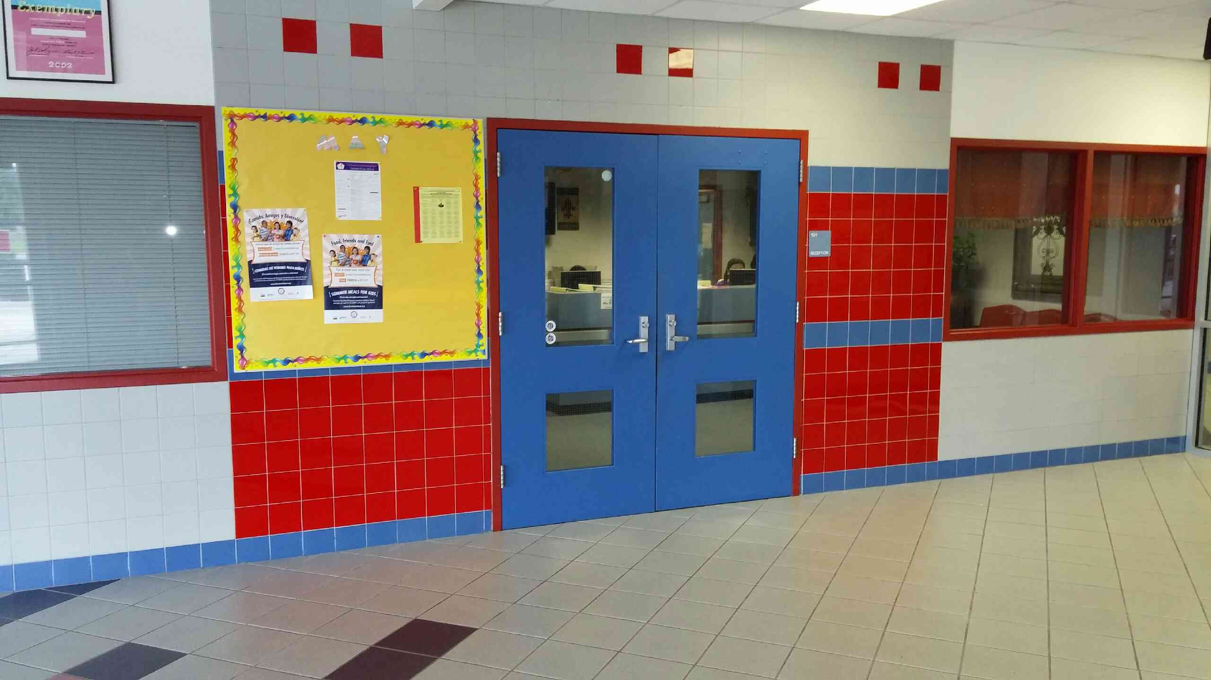
Front Office

Slide 4
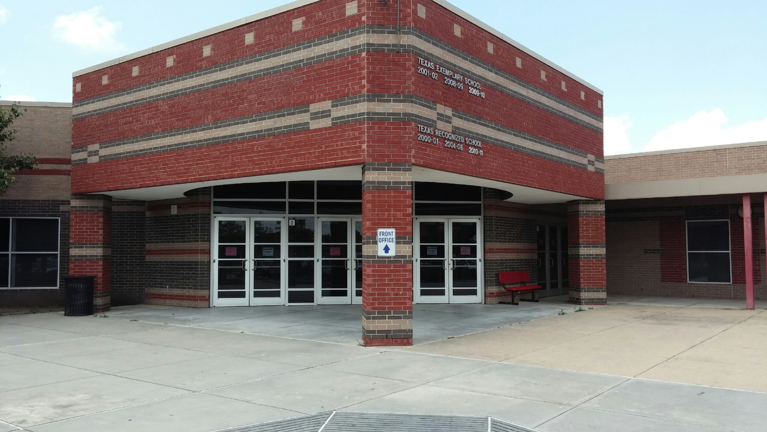
Cobb Sixth Grade Campus

Slide 5
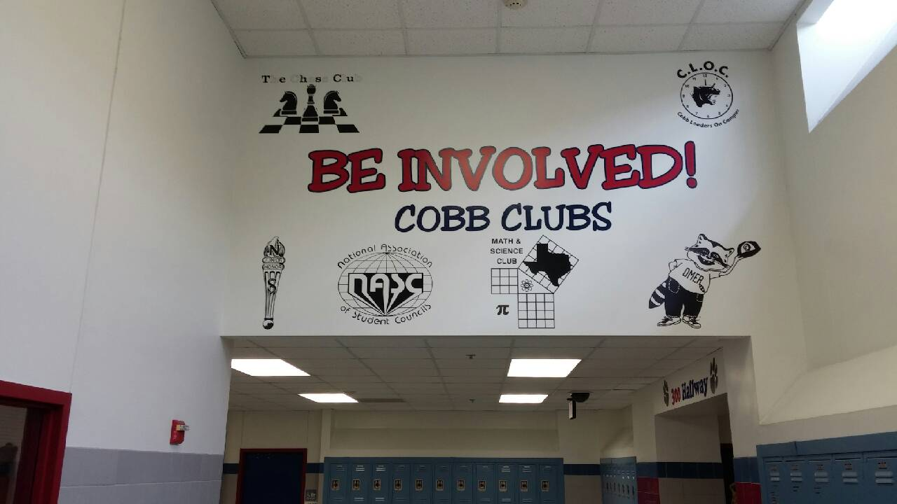
Clubs

Slide 6
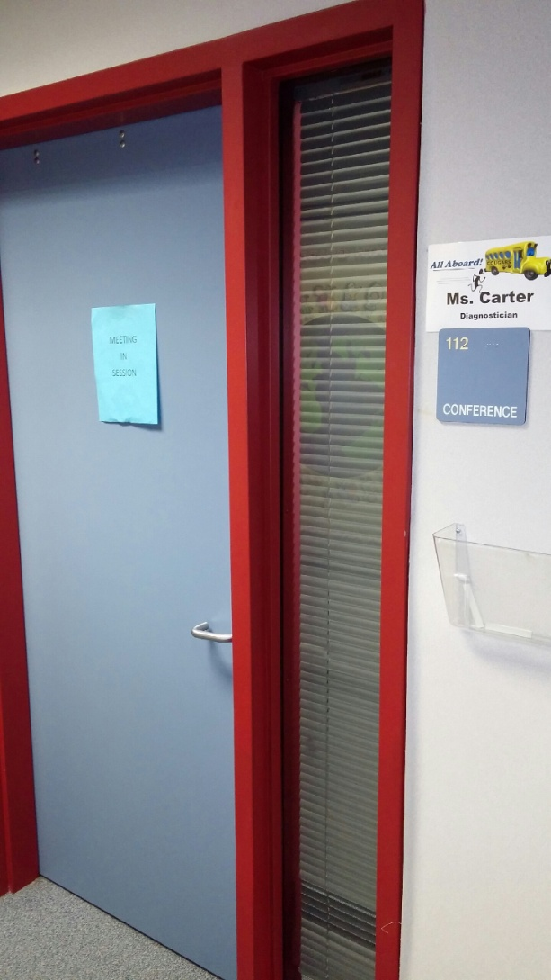
IEP Room

Slide 7
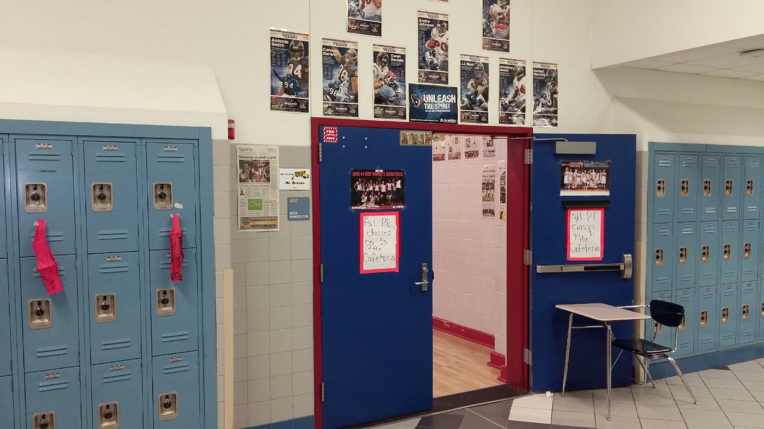
MPR (Gym)

Slide 8
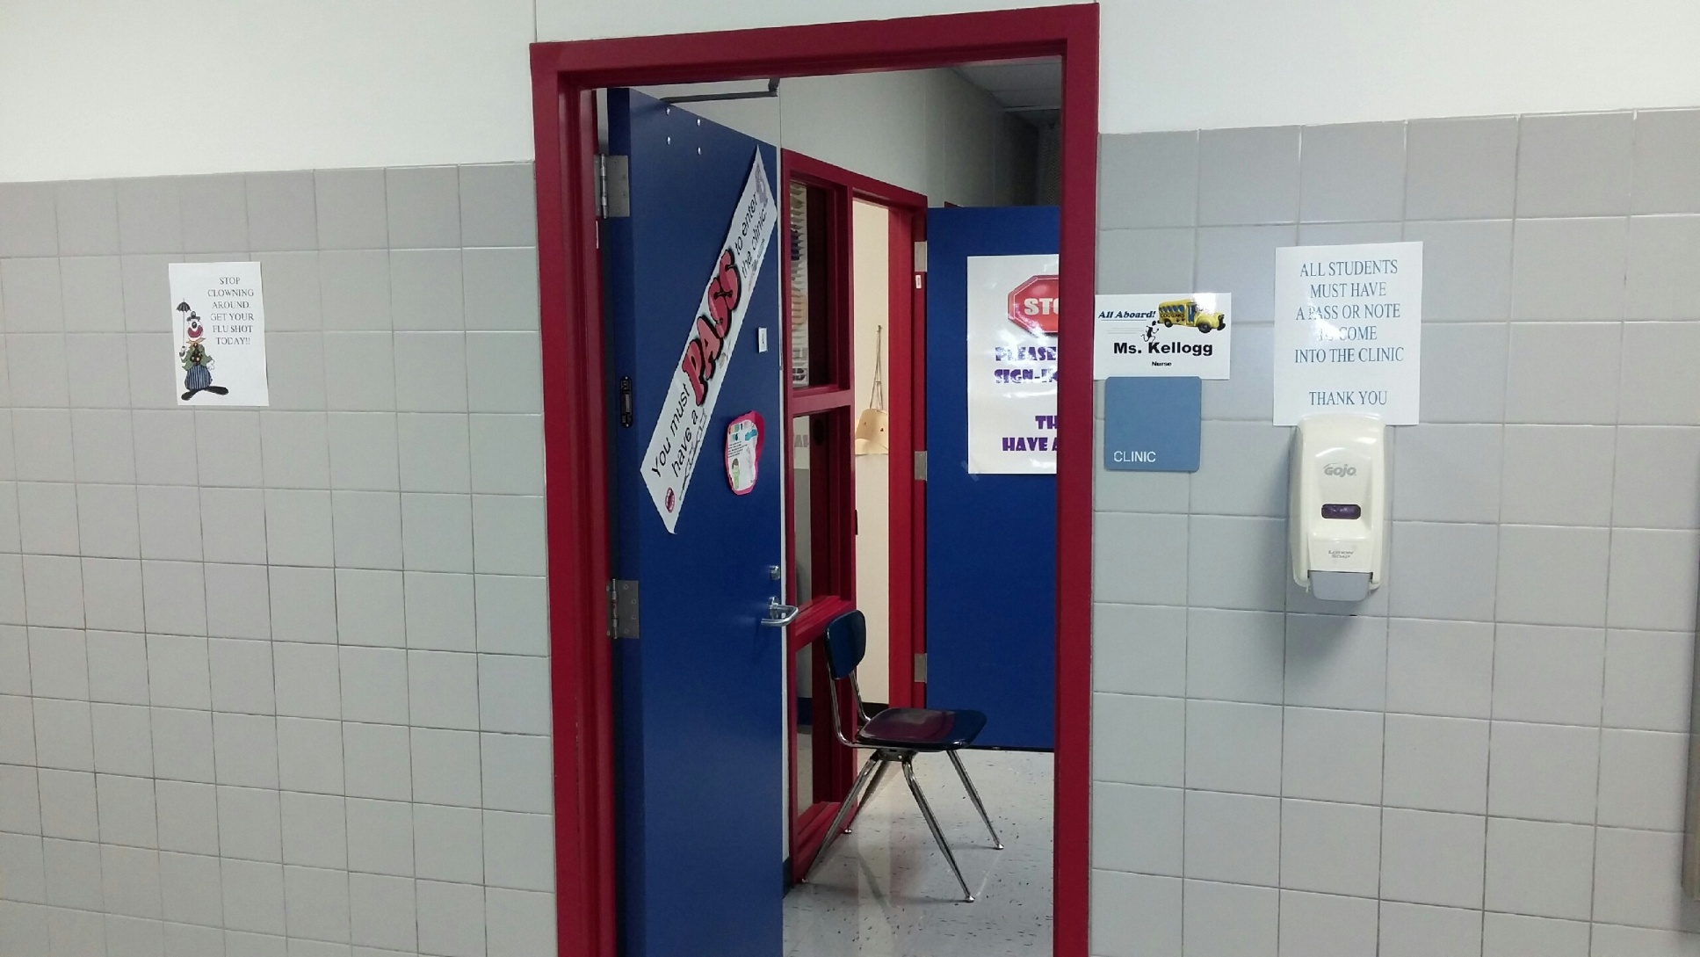
Nurse’s Clinic

Slide 9
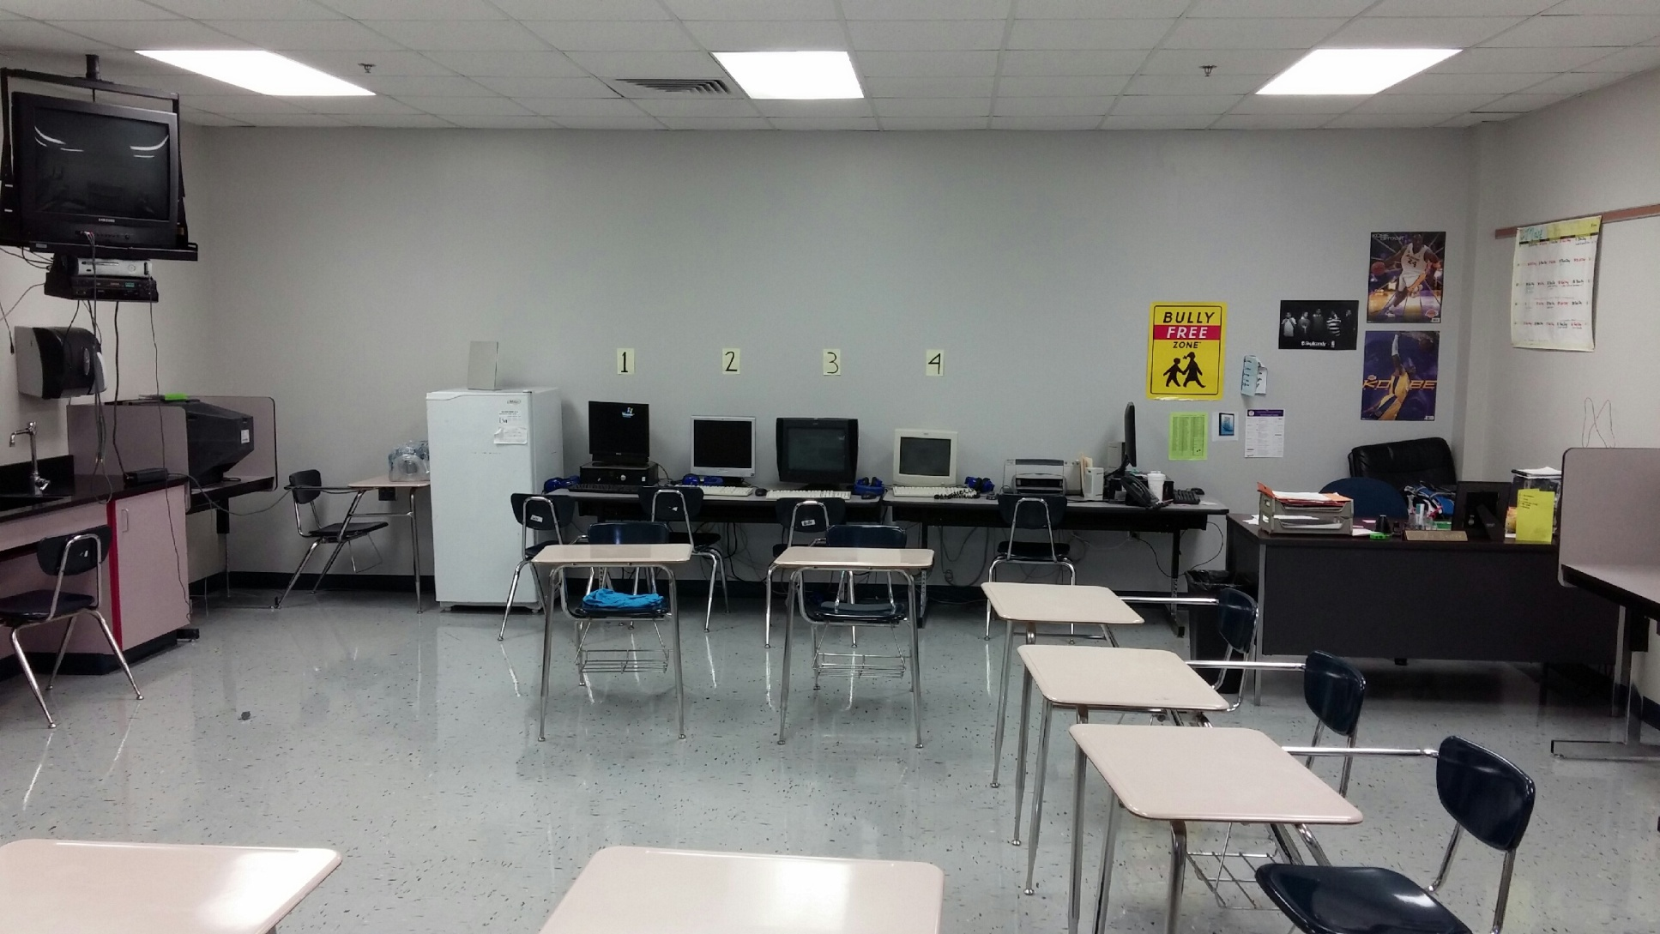
Pass Class Room

Slide 10
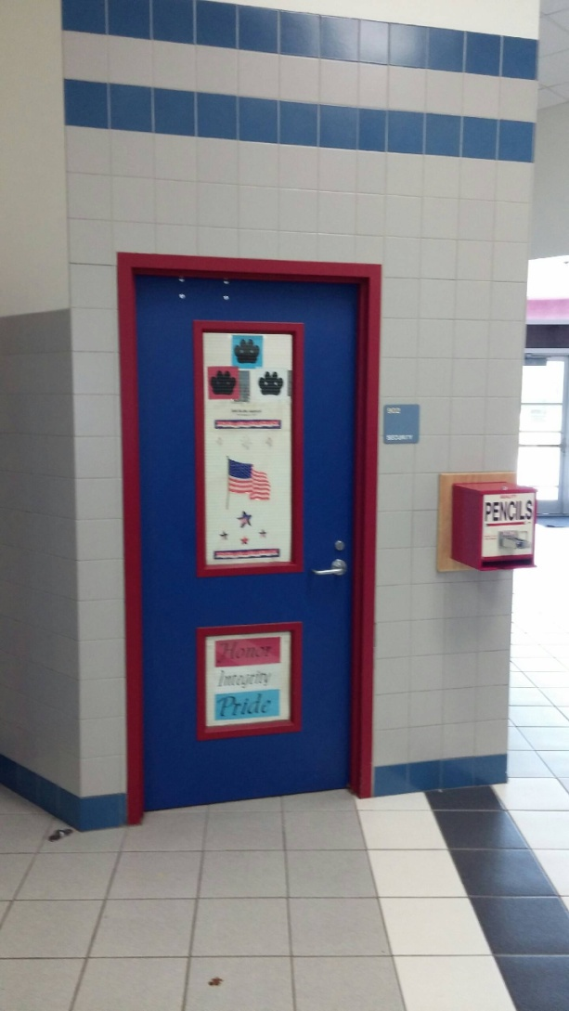
Constables Office

Slide 11
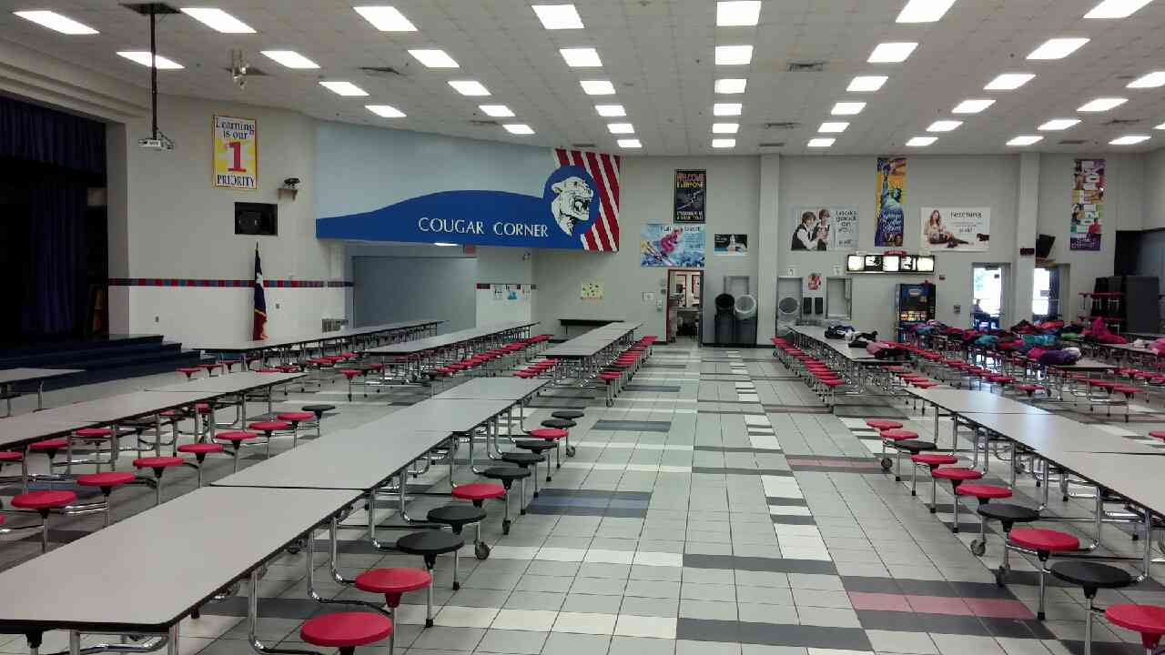
Cafeteria
Snack Bar

Slide 12
From Mr. Ashby
HAVE A GREAT SUMMER AND WE CAN’T WAIT TO SEE YOU NEXT YEAR!!

